Slide 1
Java Course
Justin Simon

Slide 2
Java is a programming language
object-oriented and secure programming language

Slide 3
Java was developed by Sun Microsystems(Now oracle) in 1995
James Gosling is known as the father of Java
Oak was the original name given later changed to java

Slide 4
Platform
Any hardware or software environment in which a program runs, is known as a platform
Java has a runtime environment (JRE) and API(Application Program interface) it is called a platform

Slide 5
Application
Web
Desktop
Mobile
Embedded
Robotics

Slide 6
Types of Application
Standalone Application
Web Application
Enterprise Application
Mobile Application

Slide 7
The current stable release of Java is Java SE 10

Slide 8
Features
Object Oriented
Platform independent
Multithreaded
Secured

Slide 9
Releases
JDK Alpha and Beta
JDK 1.0
JDK 1.1
J2SE 1.2
J2SE 1.3
J2SE 1.4
J2SE 5.0
Java SE 6…………18

Slide 10
Different from Other Technology
Java is compiled into bytecode which can run on any device with the Java Virtual Machine (JVM)
C++ is compiled directly into machine code and therefore, can only run on the same platform in which it was compiled

Slide 11
JDK Installation Path
https://www.oracle.com/in/java/technologies/javase/javase8-archive-downloads.html

Slide 12
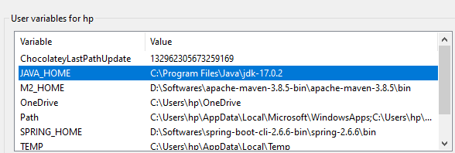
Set up

Slide 13
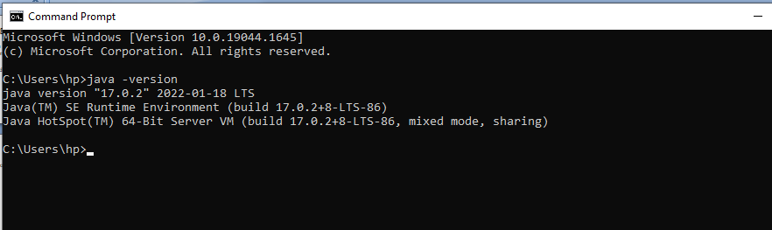

Slide 14
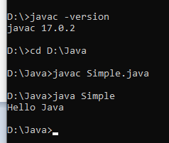

Slide 15
End Of Session 1
Thank You

Slide 16
End Of Session 1
Thank You

Slide 17
Install JDK 1.8 ,1.17
Install Eclipse IDE Corresponding to Java 8 Version
https://www.eclipse.org/downloads/packages/release/neon/3/eclipse-ide-java-ee-developers
Git-https://git-scm.com/
Tortoise Git -https://tortoisegit.org/download/
Sighn up an account in git-> https://github.com/

